Slide 1
UVM Sequence Execution

Slide 2
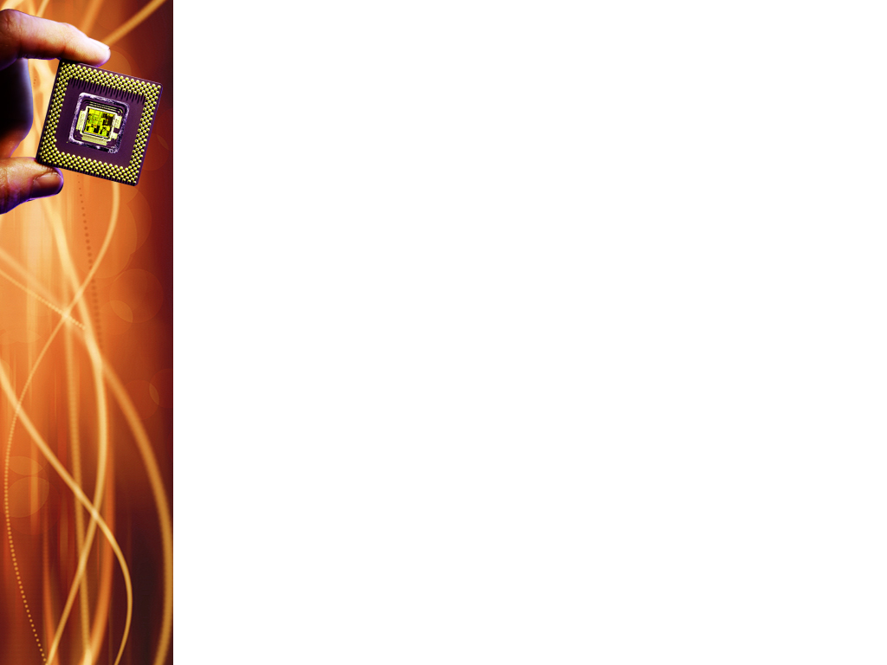
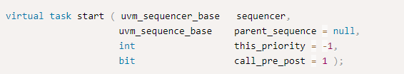
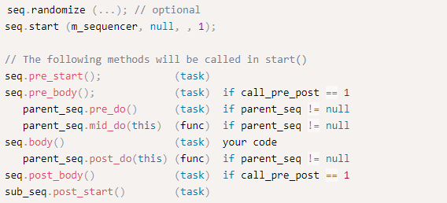
Stimulus Generation
Notes:
For the start() phase of a sequence, handle to a sequencer must always be passed that will execute the sequence. Other arguments are optional. parent_sequence refers to the sequence from which the current one was called. this_priority specifies a priority for the sequence (default assumption is priority of the parent sequence). call_pre_post will call pre_body and post_body() of the current sequence.

Slide 3
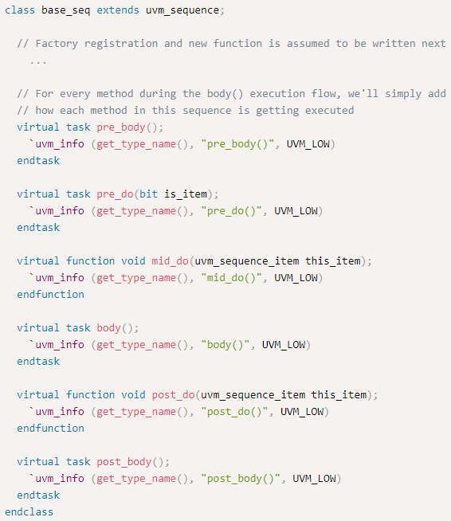
Notes:
This is a simple sequence with a print statement in each of the methods.

Slide 4
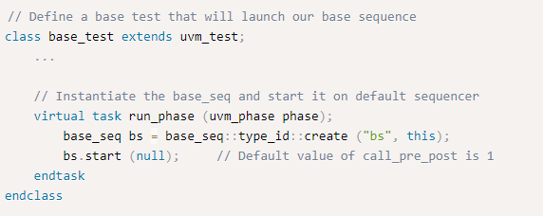
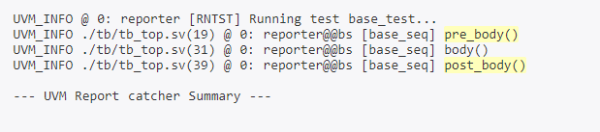
Notes:
Within the test case, the start method of the sequence base_seq is called. Note that the default value of call_pre_post argument of the start method is 1 and hence, pre_body and post_body tasks of the sequence will be called.
As expected, the sequence executes the pre_body and post_body tasks in addition to the body method.

Slide 5
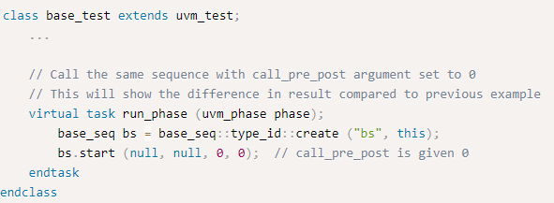
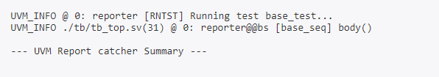
Notes:
If a 0 is supplied to call_pre_post argument, the pre_body and post_body methods are not executed.

Slide 6
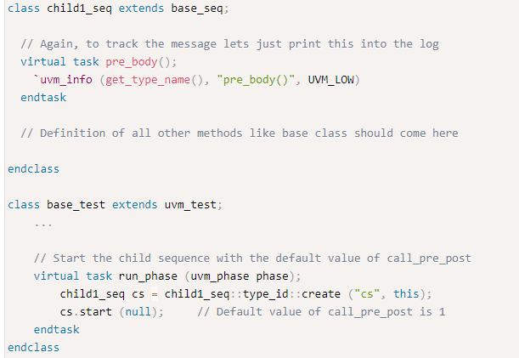
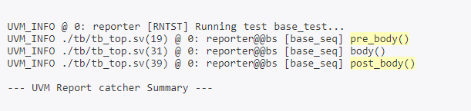
Inherited Sequence Flow
Notes:
The second argument to start method is parent , which doesn’t indicate the term parent used in inheritance, instead it is the parent sequence that starts the main sequence.
This example is to clear the confusion. A child sequence of base_seq is created with a print statement in each of its methods and spawn that from the test case.
The pre_body and post_body methods get invoked since default value of call_pre_post argument in the start method.

Slide 7
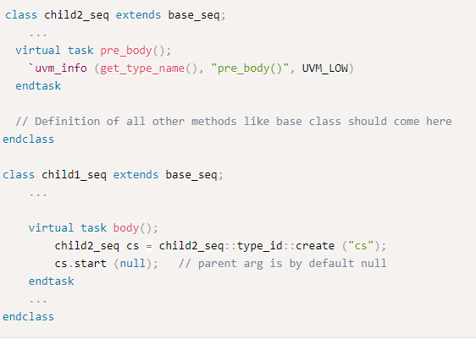
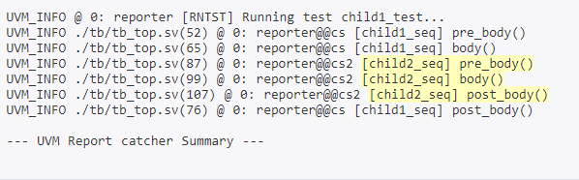
Spawned Sequence Flow
Notes:
In this example, another sequence child2_seq is called from the body method in child1_seq.
It can be seen that child2_seq also executed its own methods after which child1_seq execution is resumed.

Slide 8
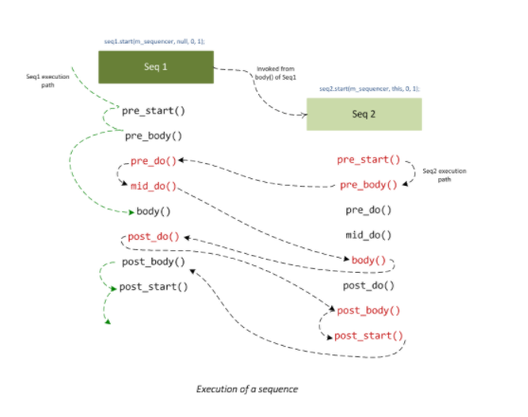
Sequence Execution Flow

Slide 9
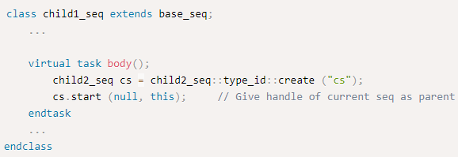
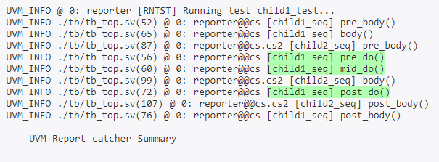
Notes:
Here, the pointer to child1_seq is supplied as an argument to the parent of the start method in child2_seq.
The pre_do, mid_do and post_do methods of the parent sequence child1_seq has been called.

Slide 10
The Remaining UVM Testbench

Slide 11
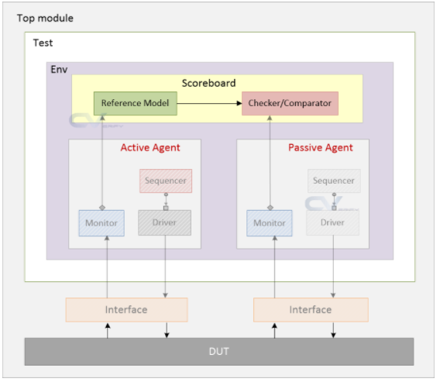
UVM Scoreboard
Notes:
The UVM Scoreboard is a verification component that contains checkers and verifies the functionality of a design. It usually receives transaction level objects captured from the interfaces of the DUT via analysis port.
What is a reference model?
On receiving data objects, the SB can either perform calculations and predict the expected value or send it to the reference model to get expected values. The reference model is also called a predictor and would mimic the functionality of the design.
The final task is to compare expected results with the actual output data from DUT.
It is recommended to inherit from uvm_scoreboard than uvm_component.

Slide 12
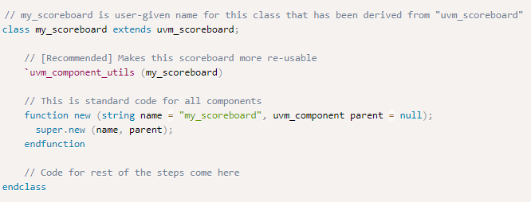
Creating a UVM Scoreboard
Step 1: Create a custom class inherited from uvm_scoreboard, register with factory, and call function new

Slide 13
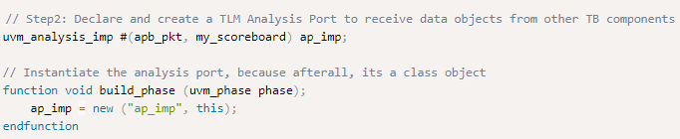
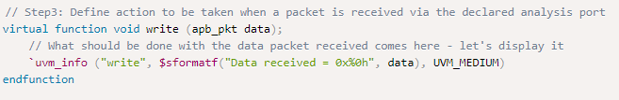
Creating a UVM Scoreboard
2. Add necessary TLM exports to receive transactions from other components. Instantiate them in build_phase
3. Define the action to be taken when data is received from analysis port

Slide 14

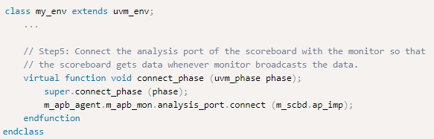
Creating a UVM Scoreboard
4. Perform checks
5. Connect analysis port of scoreboard with other components in the environment
Notes:
It is not required to perform checks only in the check_phase. Real checkers can also actively check during the run_phase.
Other components in the testbench send data to the scoreboard via an analysis port by calling the port’s write method.
For example, a monitor collects data packets from the bus interface. The packet is complete when the bus operation has received or sent all the data associated with the transfer. The monitor calls the write method of its analysis port after formulating a complete packet. The SB will get the data packet since the analysis port of the monitor and SB are connected in the environment.

Slide 15
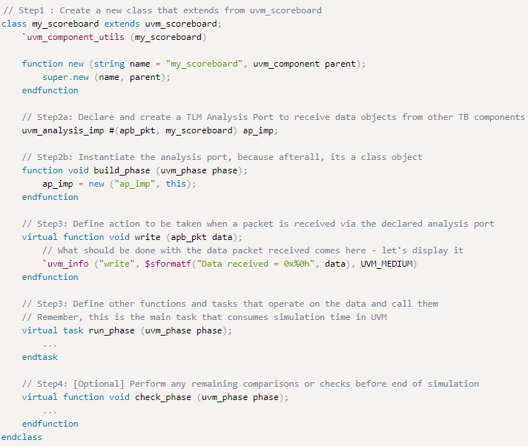
Notes:
my_scoreboard is a class inherited from uvm_scoreboard and registered with the factory.
A UVM analysis implementation port called ap_imp is defined to accept transactions of type apb_pkt (uvm_sequence_item).
Because ap_imp is also a class, an object has to be created using the new method which has been done in the build_phase.
Implementation of the analysis port is only complete when we define the write method to handle the incoming packet appropriately.

Slide 16
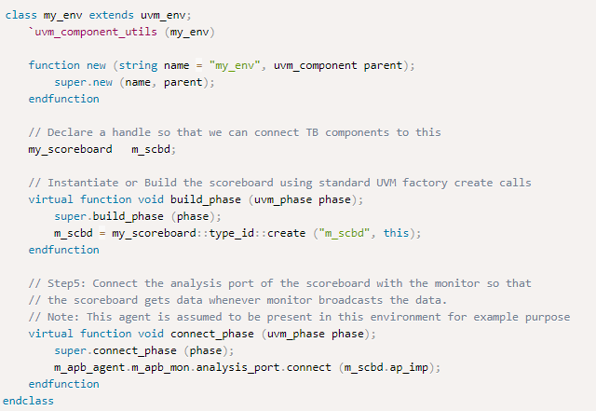
Connecting UVM Analysis ports of UVM Scoreboard
Notes:
After the SB has been defined, you need to instantiate it in the environment and connect it with the appropriate analysis ports.

Slide 17
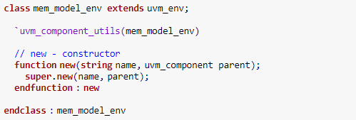
UVM Environment
Code the environment class by extending uvm_env
Declare the agent
Create the agent
Notes:
The user defined environment is derived from uvm_env, uvm_env is inherited from uvm_component.
The environment is the container class, It contains one or more agents, as well as other components such as the scoreboard, top-level monitor, and checker.

Slide 18
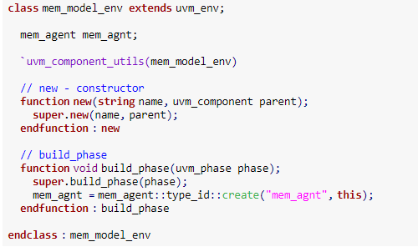
UVM Environment

Slide 19
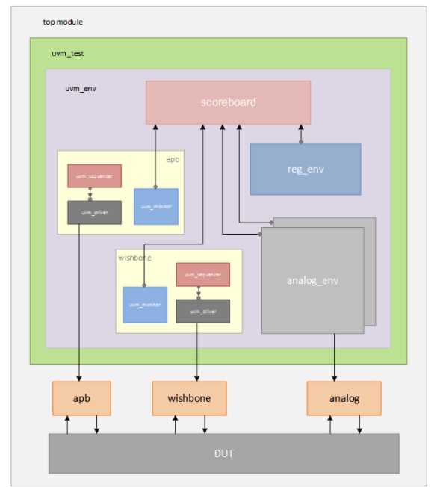
Notes:
This environment has 2 agents, 3 sub-environments and a scoreboard

Slide 20

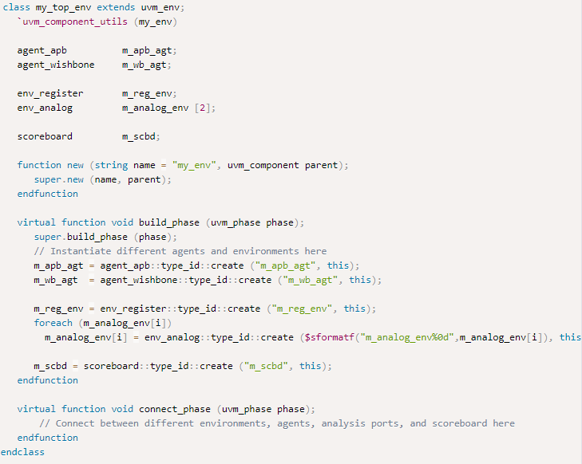
Notes:
This environment has 2 agents, 3 sub-environments and a scoreboard

Slide 21
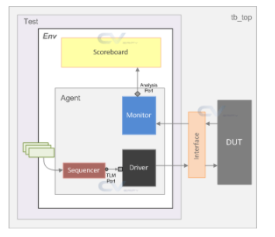

Slide 22
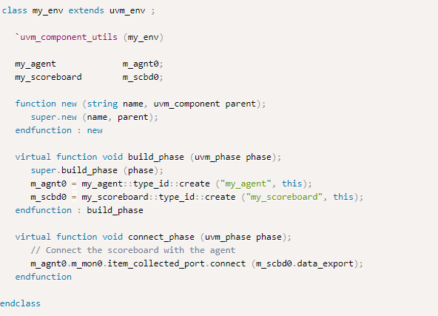

Slide 23
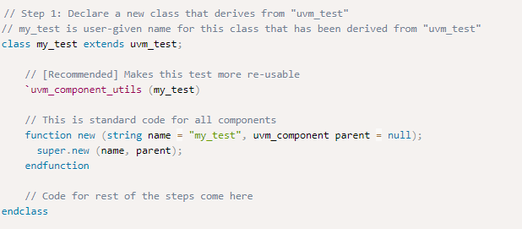
UVM Test
Code the test by extending uvm_test

Slide 24
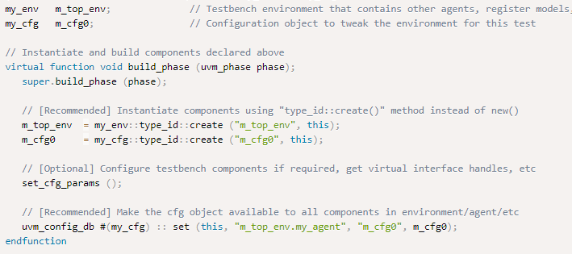
UVM Test
2. Declare other environments & verification components and build them

Slide 25

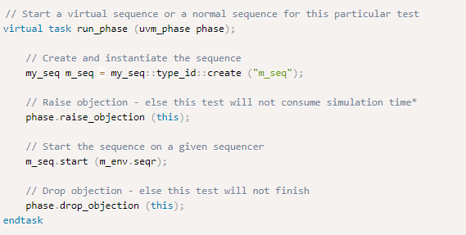
UVM Test
3. Print UVM topology (useful for debug purposes)
4. Start a virtual sequence
Notes:
UVM End of test
Usually, simulation is ended with a $finish in SV testbenches. However, in UVM, there are many phases for structural building of testbench environments. The three main phases are – build and connect, run-time and clean up.
The build-connect and clean up phases execute in zero time. But, run-time phases consume simulation time. Each phase ends when there are no more pending objections for that phase. The end of test happens when all of its time consuming phases come to an end.
Testbench components step through each phase during simulation and execution does not move to the next phase until all components in the current phase are done. This is achieved through phase objections. In other words, each component raises a flag as soon as they enter the phase and the flag is returned as soon as the component is done with what it was doing. So, until all components drop the flag, the current phase will continue. The flag implies objection here.
UVM testbench components that uses an objection mechanism, share a counter between them. The method raise_objection increments the count and drop_objection decrements the count. Once the counter reaches zero, it indicates that all participating components have dropped their objections and the phase is ready to end.

Slide 26

UVM Test
How to run a UVM test?
A test is started within the testbench_top by a task called run_test
This is a global task that must be supplied with name of user-defined UVM test to be run
Notes:
If the argument to run_test is blank, it is necessary to specify the test name via command line options to the simulator using +UVM_TESTNAME

Slide 27
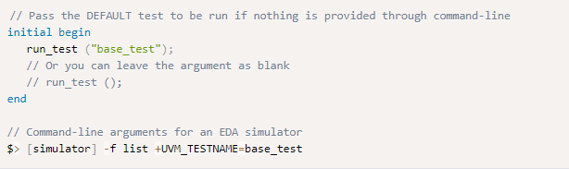
UVM Test
How to run ANY UVM test?
Notes:
This method is preferred because it allows more flexibility to choose different tests without modifying testbench_top everytime you want to run a different test. It also avoids the need for recompilation since contents of the file is not updated.
If +UVM_TESTNAME is specified, the UVM factory creates a component of the given test type and starts its phase mechanism. If the specified test is not found or not created by the factory, then a fatal error occurs. If no test is specified via command line and the argument to the run_test() task is blank, then all the components constructed before the call to run_test() will be cycled through their simulation phases.

Slide 28
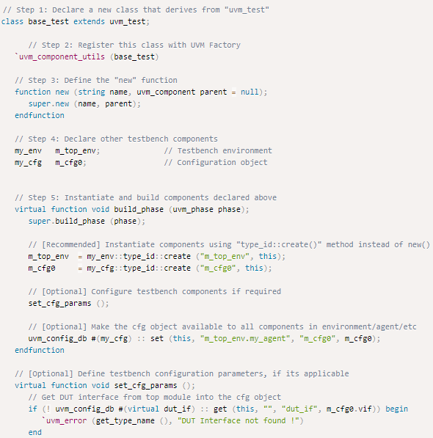
Notes:
This is an example of a UVM test in which a base_test is inherited from uvm_test.
The testbench environment m_top_env and its configuration object is created during the build_phase and setup according to needs of the test. It is then placed into the configuration database using uvm_config_db so that other testbench components within this environment can access the object and configure sub components accordingly.

Slide 29
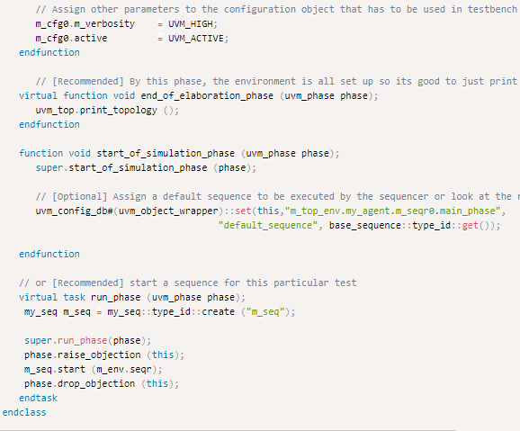
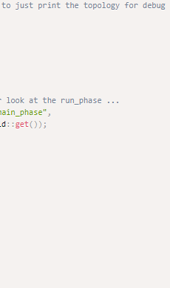
Notes:
The UVM topology task print_topology displays all instantiated components in the environment and helps in debug and to identify if any component got left out.
A test sequence object is built and started in the environment virtual sequencer using its start method.

Slide 30
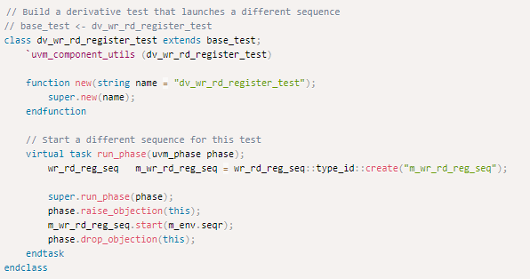
Derivative Tests
Notes:
A base test helps in setup of all basic environment parameters and configurations that can be overridden in derivative tests.
Since there is no definition for build_phase and other phases that are defined differently in dv_wr_rd_register_test, its object will inherently call its parent’s build_phase and other phases because of inheritance.
Function new is required in all cases and simulation will give a compilation error if it is not found.
In this example, only run_phase will be overridden with new definition in derived test and its super call will invoke the run_phase of base_test

Slide 31
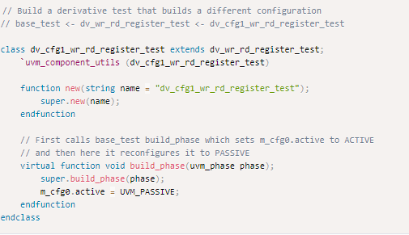
Derivative Tests
Notes:
Assume that you want to run the same sequence as in dv_wr_rd_register_test, but instead want this test to be run on a different configuration of the environment. In this case, we can have another derivative test of the previous class and define its build_phase in a different way.

Slide 32
UVM Testbench Top
Testbench top is the module that connects the DUT and the Verification environment components.
It contains:
DUT instance
Interface instance
run_test method
Virtual interface set_config_db
Clock and reset generation logic
Wave dump logic

Slide 33
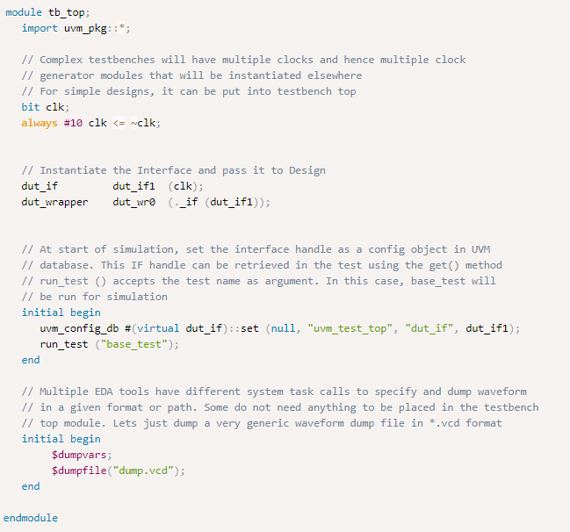
Notes:
tb_top is a module and is a static container to hold everything else
It is required to import uvm_pkg in order to use UVM constructs in this module
Clock is generated in the testbench and passed to the interface handle dut_if1
The interface is set as an object in uvm_config_db via set and will be retrieved in the test class using get methods
The test is invoked by run_test method which accepts name of the test class base_test as an argument
Call waveform dump tasks if required

Slide 34
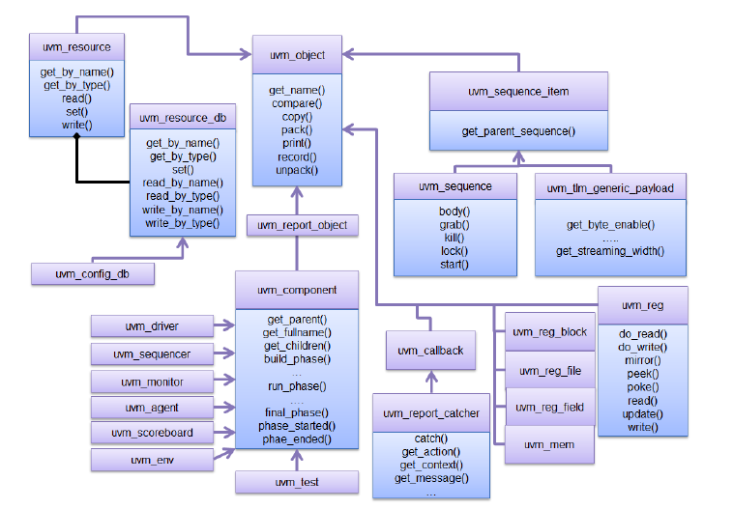
UVM Class diagram - Review

Slide 35
Reset Handling
Challenges in handling of hardware resets in a verification environment:
Reset has to be propagated to all testbench components
All UVM components such as driver, monitor, scoreboard must be capable of reacting to the reset (reset aware)
All pending sequences already scheduled by the test must be removed from all sequencers and virtual sequencers
Once the system gets out of reset, the traffic must be re-generated to the DUT.

Slide 36
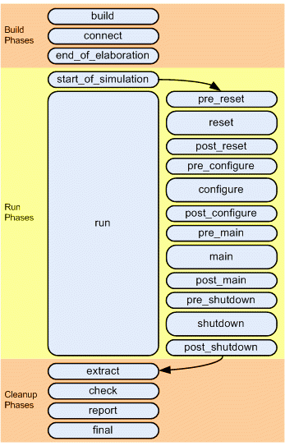
Reset Handling
Notes:
The run phase is partitioned into 12 sub-phases, all being tasks in nature (time is consumed by these sub-phases).

Slide 37
Reset Handling
pre-reset:
Starts at the same time as run phase.
Takes care of any activity that should occur before reset(eg: waiting for power signal to go active)
reset:
Used to generate reset to put the DUT/interface into a default state
post_reset:
For any activity required just after the reset phase.

Slide 38
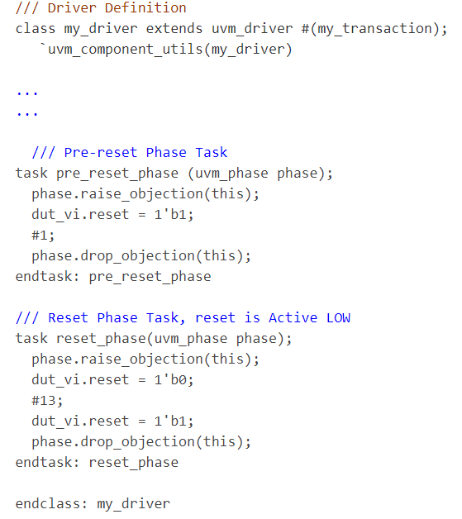
Notes:
In this UVM driver code example, dut_vi is the virtual interface declaration that is made inside the driver. Inside the reset_phase, the reset signal (dut_vi.reset) will be driven LOW to assert the reset and after some time (13 ns) the reset signal is driven HIGH to de-assert the reset and the DUT will be out of reset at this point.

Slide 39
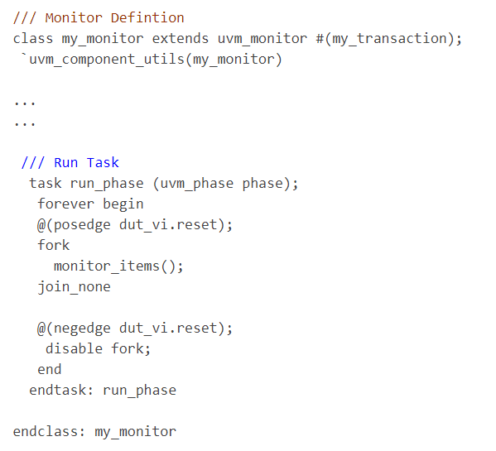
Reset Handling for Monitor
Notes:
Monitor is present in a uvm agent (regardless of active or passive), and receives the pin-level interface signals, after which it transforms these signals into transaction objects. So, as soon as reset signal is asserted, monitor should disable the process of data collection from the interfaces.
Multiple/Intermediate reset
On power ON, a reset is generated. But, there may be test scenarios where you may want to reset the DUT after the 1st sequence is over, and run the same or different sequence to test DUT behavior without getting it to power down. So, a new reset is triggered without coming out of the UVM phases.
In this example, in the run_phase task forever loop, monitor_items() task is waiting for dut_vi.reset signal positive edge (reset is de-asserted for active LOW reset). Once the condition is met, monitor_items is spawned from the fork..join_none and the monitor starts collecting the transactions. If there is an upcoming or intermediate reset that comes in the negedge of dut_if.reset (active LOW), the fork process is disabled and monitor_items task is stopped. This is what is expected when a reset occurs (no transactions are collected from input or output ports).

Slide 40
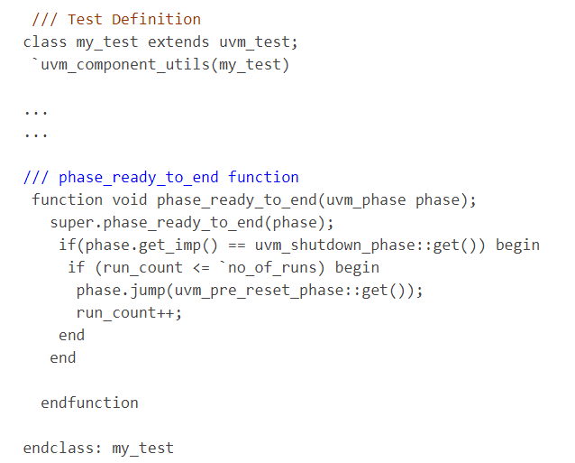
Reset Handling in Sequencer
Notes:
Whenever there is a UVM phase JUMP instruction, all ongoing transactions are stopped and the internal FIFOs that are involved in holding the running transactions on that sequencer are cleared.
In UVM, the Test ending mechanism is via Raise Objections and Drop Objections. So the indication of finishing a Sequence is that all the Raised Objections are Dropped and the Objection counter value will be zero at this point. Now phase_ready_to_end() function defined above comes into action. phase_ready_to_end() is called whenever the total objection count for the current phase decrements to 0.
From the above code, its clear that once the phase is shutdown_phase (which is last Sub-phase out of the 12 Run Sub-phases) & there is no pending Objection, phase_ready_to_end is activated and make a JUMP to the pre_reset_phase(). From there on, the whole cycle is repeated. This way, the whole process is re-started again & a new RESET is generated.
This approach can be further extended to Test the scenario where Reset is triggered in-between of the Sequence execution instead of after completing the Sequence.

Slide 41
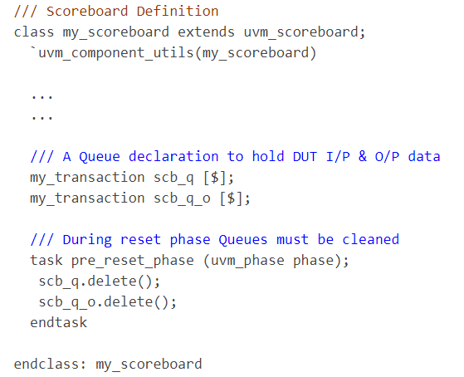
Reset Handling in Scoreboard
Notes:
Usually, queues are used inside SB to hold the incoming stream of data transactions. Upon reset, the queues inside the SB must be cleared and all existing elements need to be flushed out. SB doesn’t have any direct access to the interface, it works with UVM analysis imports and deals with transaction objects. Queues can be flushed out in pre_reset_phase().

Slide 42
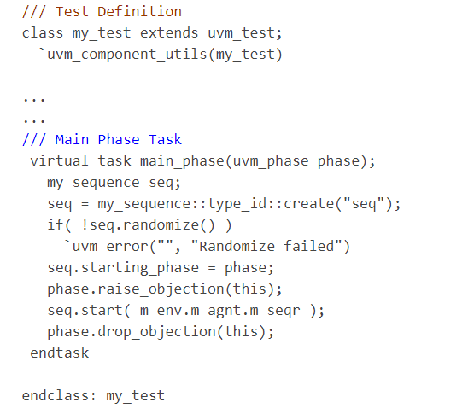
Reset Handling in Sequence
Notes:
Sequence is the dynamic that generates stimulus for DUT. In terms of multiple reset handling, sequence must be stopped once reset is asserted and must be restarted automatically upon de-assertion of reset.
In this example, sequence is started on the sequencer m_seqr once the main_phase is entered. So, if we’re able to recycle the UVM phasing flow, sequence will be automatically started on the defined sequencer.

Slide 43
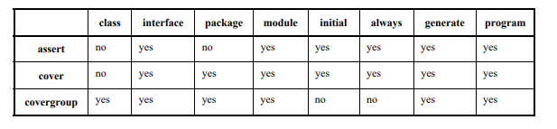
Implementing coverage & checks
Notes:
For a coverage-driven verification, checks and coverage are required. The table depicts SV checks and coverage construct usage.
Checks and coverage can be defined in multiple locations based on category of functionality being analyzed.

Slide 44
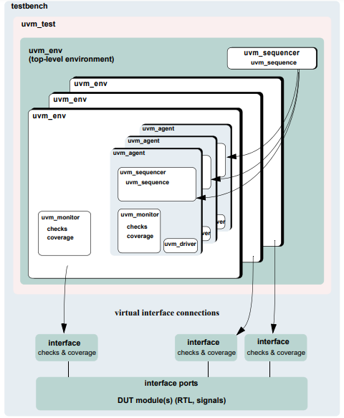
Notes:
Here, checks and coverage are depicted in uvm_monitor and interface

Slide 45
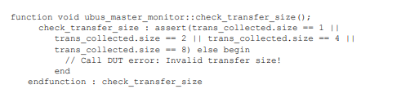
Implementing coverage & checks in classes
Implemented in classes derived from uvm_monitor
Write checks as procedural code or SV immediate assertions
TIP: Use immediate assertions for simple checks (written in few lines of code).
Use functions for complex checks (many lines of code)
Notes:
As checks become more complicated, so does their debugging.
Concurrent assertions are not allowed in SV classes.
In the example of an assertion check, the assertion verifies that the size field of the transfer is 1, 2, 4, or 8. Otherwise, the assertions fails.

Slide 46


This is procedural-code example of a check.
Execution of checks by call to the check functions.
Notes:
The first example is a functional check that verifies the size field value matches the size of the data dynamic array.
The proper time to execute checks is implementation-dependent. In this example, both checks must be implemented after the transfer is collected by the monitor. Since these checks happen at the same instance of time, a wrapper function is created so that only one call has to be made. The perform_transfer_checks function is called procedurally after the item has been collected by the monitor.

Slide 47
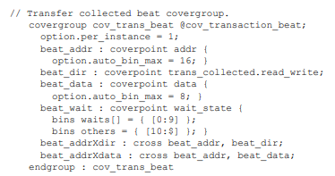
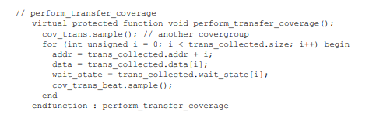
Notes:
Functional coverage is implemented using SV covergroups. Details of the covergroup (coverpoints, when to sample coverage, what bins to create) must be planned and decided prior to start of implementation. The first example shows a simple covergroup. This embedded covergroup is defined inside a class derived from uvm_monitor. For the covergroup, assign local variables that serve as coverpoints in a function, then sample the covergroup. This is for each transaction data beat of the transfer to be covered.
The second example shows the function. The function covers several properties of the transfer, with each element of the dynamic array data. SV doesn’t provide ability to cover dynamic arrays. Each element must be accessed individually to cover that value, if required.

Slide 48
Implementing Coverage & Checks in Interfaces
Checks implemented as assertions
Assertions related to physical interface are placed in env’s interface
Assert is used when the property expresses behavior of DUT
Assume is used when the property expresses behavior of the environment that generates stimulus to DUT
Notes:
Assertions are added to check signal activity for a protocol.
Assert along with assume properties are used to express interface checks.

Slide 49
Controlling coverage and checks
If checks_enable is 0, the function that performs the checks is not called.
Notes:
There must be some means to control whether checks are enforced and coverage is collected. The UVM bitfield is used for this purpose, which is controlled using the uvm_config_db.
Similar to checks_enable, even coverage_enable field can be used in the monitors.

